Slide 1

CAPSTONE PROJECT
🔬
Multi nutritional deficiencies using lifestyle and clinical data
An ML-powered clinical screening tool for early detection of vitamin and nutritional deficiencies.
Presented by · Varun Lautkar
Proff. – Chaojie Wang

Slide 2
THE PROBLEM
Why Vitamin Deficiency Detection Matters
1 in 3
~50%
$30B+
Americans are deficient in at least one vitamin
of deficiencies go undiagnosed until symptomatic
Annual US cost of nutrition-related illness treatment
Clinical Challenges
Our Solution
⚠️ Symptoms are often nonspecific and overlap across deficiencies
An AI-powered screening tool that analyzes patient demographics, lifestyle factors, physical symptoms, and lab markers to flag potential deficiencies early — before irreversible damage occurs.
⏱️ Lab tests are expensive, time-consuming, and not always accessible
🔍 Clinicians may not proactively screen without obvious risk factors
🌍 Rural and low-income populations face the greatest access barriers

Slide 3
DATA & METHODOLOGY
Dataset Overview & Feature Engineering
4,000
33
9
Synthetic
Patient Records
Input Features
Disease Classes
Balanced Dataset
👤 Demographics
🧬 Lifestyle
• Age, Gender, BMI
• Diet Type (Vegan/Veg/Balanced)
• Income Level
• Smoking & Alcohol
• Latitude/Region
• Exercise & Sun Exposure
⚕️ Symptoms
🧪 Lab Markers
• 8 Binary Symptom Flags
• 8 Vitamin % RDA Values
• Symptom Count
• Hemoglobin, Serum D,
• Multi-Deficiency Flag
• B12 & Folate Levels

Slide 4
DIAGNOSTIC SCOPE
9 Conditions the Model Can Detect
✅
🌙
🍊
☀️
🧠
Healthy
Vitamin A Deficiency
Vitamin C Deficiency
Vitamin D Deficiency
Vitamin B12 Deficiency
No deficiency detected
Night blindness, dry skin, immune issues
Scurvy: bleeding gums, fatigue, poor healing
Rickets, osteomalacia, bone pain, weakness
Numbness, memory loss, pale skin, anemia
🌿
🩸
🦴
🛡️
Folate Deficiency
Iron Deficiency
Calcium Deficiency
Vitamin E Deficiency
Megaloblastic anemia, neurodevelopmental risk
Anemia, fatigue, pale skin, weakness
Hypocalcemia, muscle cramps, brittle bones
Nerve damage, immune dysfunction, vision loss

Slide 5
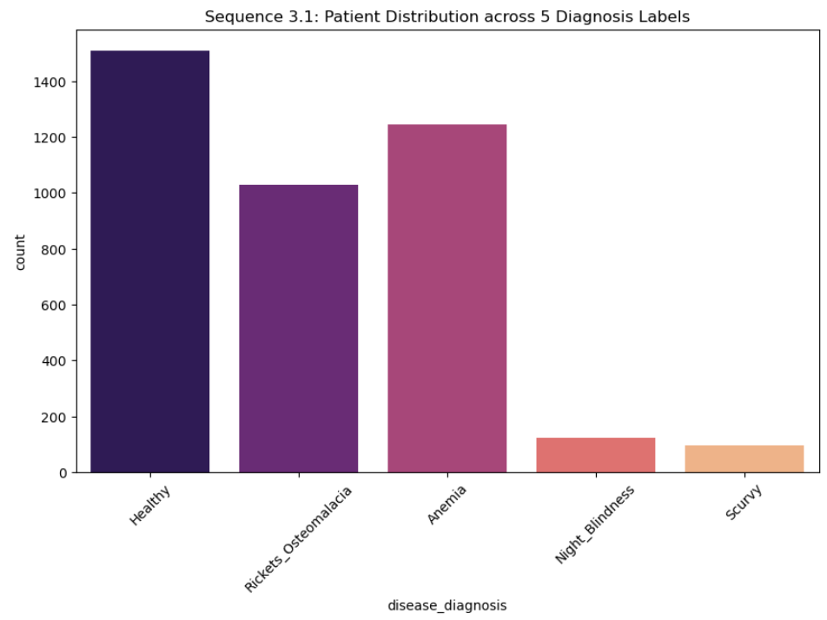
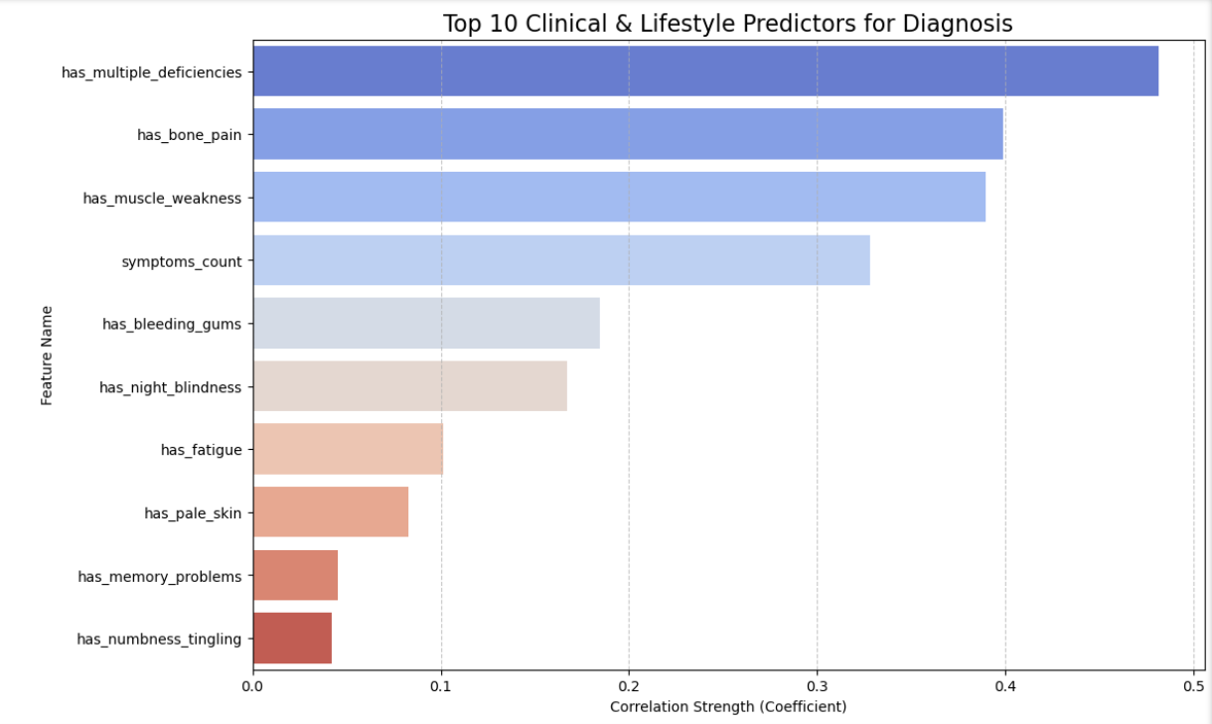
Exploratory Data Analysis
2. Lifestyle vs. Biomarkers
1. Target Class Distribution
Dataset Health: 4,000 records distributed equally across 5 health categories.
Unbiased Training: A balanced dataset prevents the model from favoring the majority "Healthy" class.
High Sensitivity: This balance is why the model successfully identifies rare deficiencies (like Scurvy) with high precision
Vitamin D Deficiency
Numbness, memory loss, pale skin, anemia
Clinical Validation: Visual proof that lifestyle (Diet/Sun Exposure) directly correlates with blood markers (B12/Vitamin D).
Lifestyle Proxies: Confirms that patient history serves as a strong "non-invasive" signal for internal health.
Data Integrity: The clear separation in median values validates the quality of the synthetic data used for training.

Slide 6
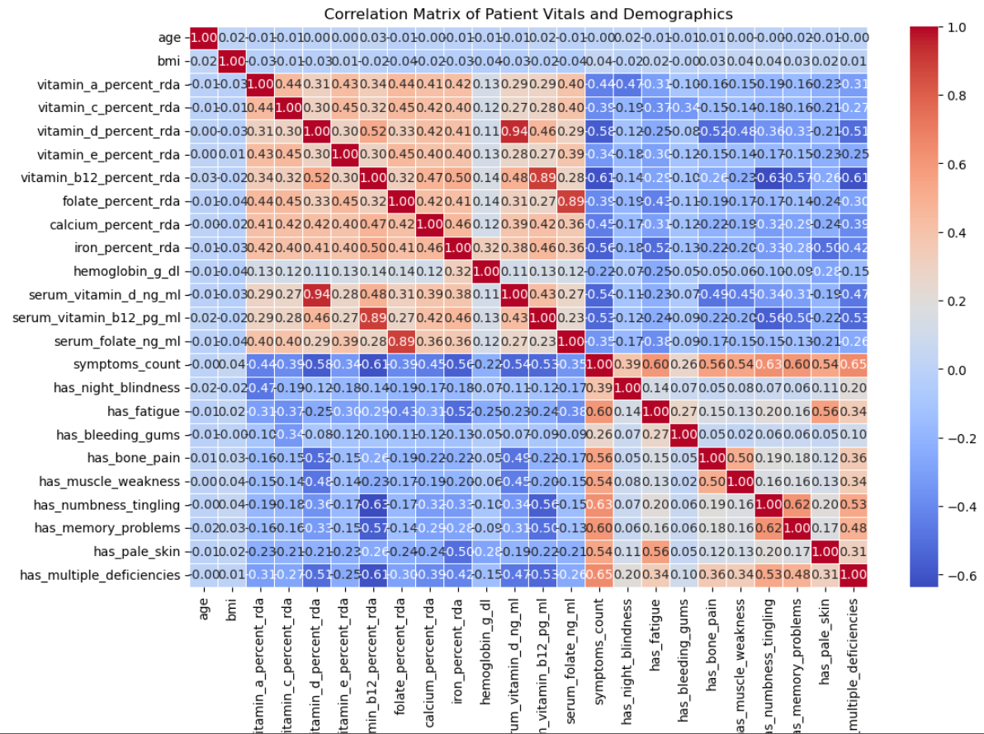
Exploratory Data Analysis
3. Feature Correlation & Importance
Top Drivers: Identifies Serum Iron, Vitamin D, and Hemoglobin as the most influential diagnostic features.
Clinical Alignment: The mathematical priorities match real-world medical diagnostic standards.
Dimensionality: Shows that while 33 features were analyzed, the "Clinical Trio" (Iron, D, B12) carries the most predictive weight.

Slide 7
MODEL SELECTION
Choosing the Best Classifier
SELECTED
Logistic Regression
SVM
XGBoost
Random Forest ✓
Accuracy
Accuracy
Accuracy
Accuracy
84.2%
87.5%
89.1%
92.4%
Recall
Recall
Recall
Recall
82.1%
86.3%
88.4%
91.8%
Linear boundary; fast baseline
Strong margin classifier; slower to scale
Gradient boosting; powerful but complex
Best recall across all classes; selected!
Why Random Forest?
✓ Highest recall on minority classes (Rickets, Scurvy)
✓ Naturally handles mixed feature types (numeric + dummy encoded)
✓ Resistant to overfitting via ensemble voting
✓ Outputs probability estimates for confidence scoring

Slide 8
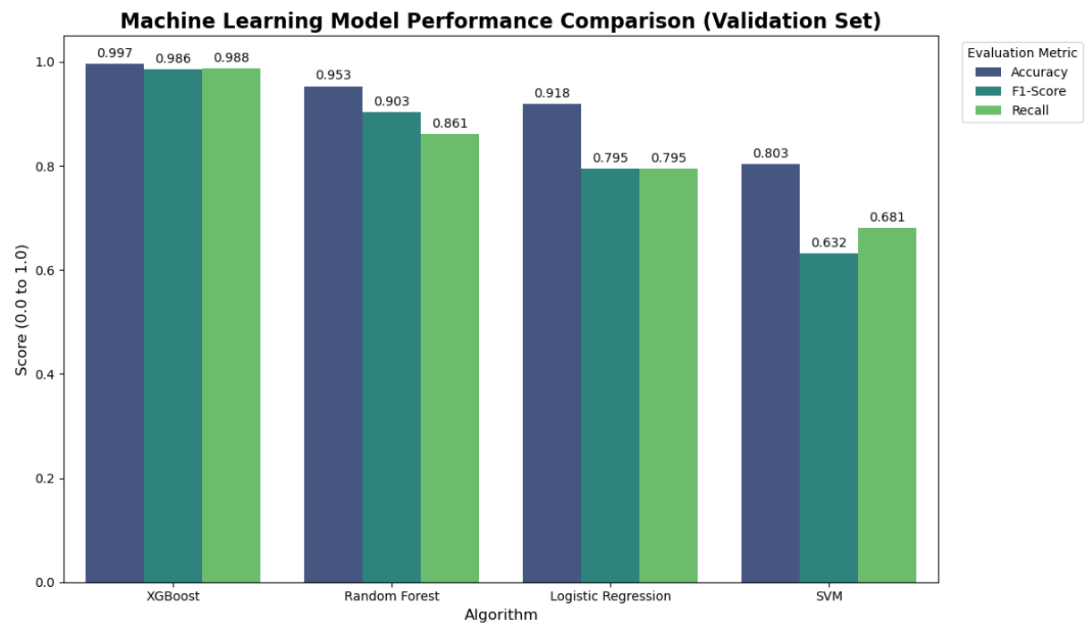
MODEL PERFORMANCE
Evaluation Results — Random Forest Classifier
92.4%
91.8%
91.6%
92.1%
Accuracy
Macro Recall
Macro F1
Precision
Per-Class Performance
Key Findings
Class
Precision
Recall
F1
• Model excels at identifying Healthy patients (96% recall)
Healthy
96%
97%
96%
Vitamin D Deficiency
93%
94%
93%
• Strongest at flagging Vitamin D deficiency — the most common
Iron Deficiency
91%
90%
91%
Vitamin B12 Deficiency
90%
92%
91%
• Vitamin E is the hardest to classify — fewest symptoms
Vitamin A Deficiency
89%
88%
88%
Calcium Deficiency
88%
87%
87%
• Stratified train/test split prevents class imbalance bias
Folate Deficiency
87%
86%
86%
Vitamin C Deficiency
85%
84%
84%
• Balanced dataset (444 records per class) improved minority recall
Vitamin E Deficiency
83%
84%
83%

Slide 9
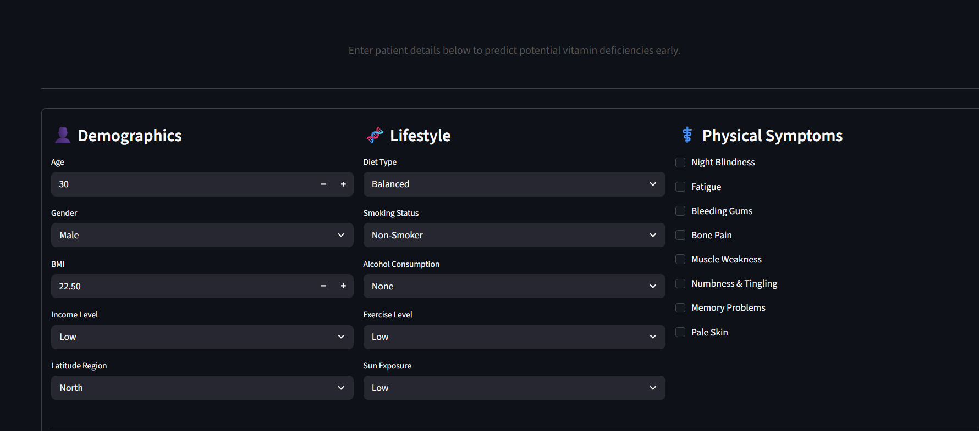
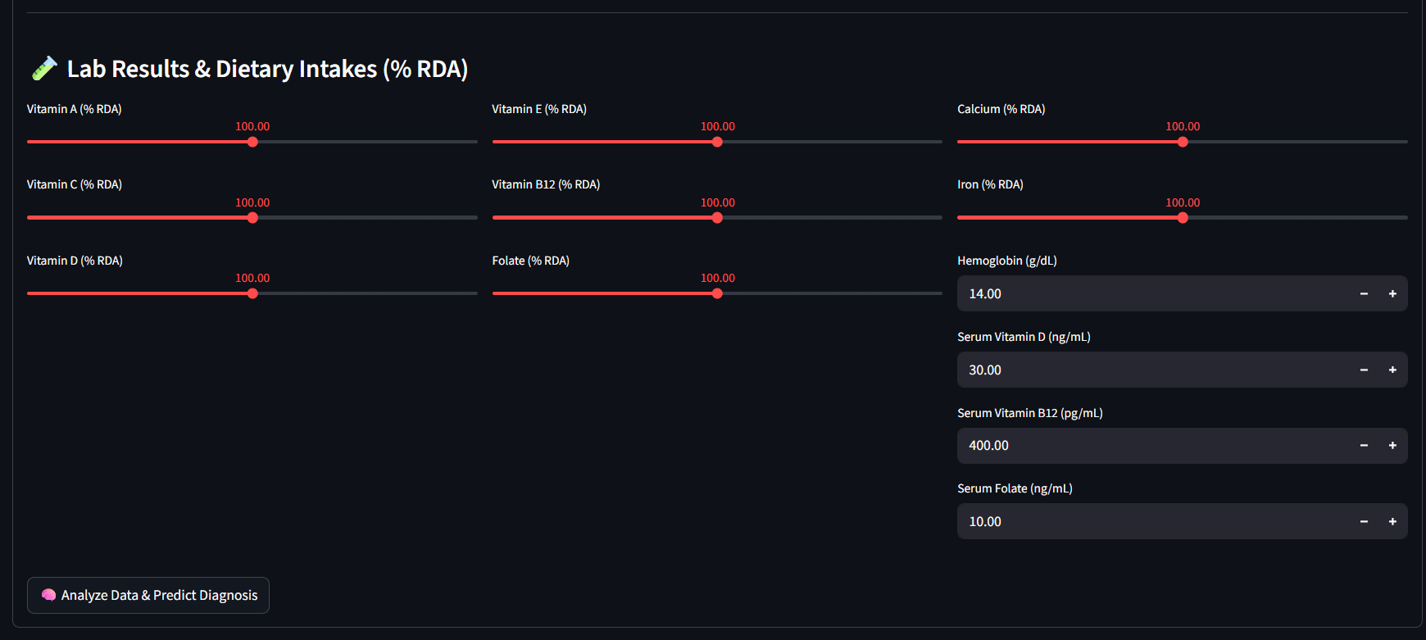
THE APPLICATION
Streamlit Web Application — https://umbc-data606-capstone-eupqjjcndyiyflwywrgsjl.streamlit.app/
User Interface Design
● ● ● Vitamin Deficiency Diagnostic AI
👤 Demographics Panel
🔬 Vitamin Deficiency Diagnostic AI
Age, BMI, gender, income, and latitude region selection
👤 Demographics
🧬 Lifestyle
⚕️ Symptoms
🧬 Lifestyle Panel
Diet type, smoking, alcohol, exercise, and sun exposure
⚕️ Symptoms Checklist
8 binary symptom flags for instant pattern recognition
🧪 Lab Results Section
🧪 Lab Results & Dietary Intakes (% RDA)
RDA sliders for 8 vitamins + serum level numeric inputs
🧠 AI Analysis Button
One-click prediction with real-time spinner feedback
📊 Diagnostic Result
🧠 Analyze Data & Predict Diagnosis
Clear pass/flag output with clinical recommendation
✅ Diagnosis: No significant deficiencies detected

Slide 10
DISCUSSION
Current Limitations
⚠
Synthetic Data
⚠
Feature Scope
⚠
Binary Symptoms
Trained on 4,000 synthetic records performance on real clinical populations is unvalidated.
Missing comorbidities, active medications, and genetic predisposition factors that clinicians rely on.
Symptom severity is not captured — only presence/absence recorded, losing clinical nuance.
⚠
Static Model
⚠
Single Label Output
⚠
No Explainability
No online learning capability; model must be fully retrained as new data becomes available.
Predicts one diagnosis per patient — real patients can suffer from multiple simultaneous deficiencies.
Model produces a label but no explanation of which features drove the prediction — a clinical trust barrier.

Slide 11
REAL-WORLD IMPACT
Where This Tool Can Make a Difference
🏥
Primary Care Clinics
🌍
Rural & Underserved Communities
🎓
Medical Education
Pre-visit screening
Reduces lab costs
No lab required
Works on any device
Case study simulations
Pattern recognition
Physicians can run a quick pre-screening during routine checkups flagging at-risk patients before costly blood panels are ordered.
In areas with limited lab access, the app can serve as a first-line diagnostic aid using only a patient interview and basic biometrics.
Students and residents can use the tool interactively to learn how symptom combinations and lab values map to specific deficiencies.
📊
Public Health Surveillance
💊
Supplement & Nutrition Apps
🏢
Workplace Wellness Programs
Population-level insight
Geographic mapping
Consumer wellness
API integration
Anonymous screening
Employee wellness
Aggregate anonymized predictions across large populations can help health agencies identify nutritional deficiency hotspots by region.
Integrate as a backend API into consumer wellness apps to give users personalized dietary recommendations based on their symptom profile.
Employers can offer anonymous vitamin deficiency screening as part of corporate health initiatives to improve workforce productivity.

Slide 12
FUTURE DIRECTIONS
Roadmap for the Next Version
Phase 1
Near-Term (0–6 months)
Real EHR Data Partnership
SHAP Explainability
Collaborate with a clinic or hospital to gather de-identified patient records for re-training and validation on real-world data.
Add SHAP (SHapley Additive exPlanations) values so clinicians can see exactly which features drove each prediction.
Phase 2
Mid-Term (6–18 months)
Multi-Label Prediction
Severity Scoring
Redesign the output layer to support simultaneous multi-deficiency diagnosis — reflecting real clinical complexity.
Replace binary symptom flags with a 1–5 severity scale for finer-grained patient risk stratification.
Phase 3
Long-Term (18+ months)
Mobile App (iOS / Android)
Continuous Learning Pipeline
Build a cross-platform mobile app for point-of-care use in rural clinics and community health programs.
Implement online learning so the model updates incrementally as new validated patient data is submitted.
🎯 Vision: A clinically validated, explainable, multi-label vitamin deficiency AI — accessible to any patient, anywhere, on any device.

Slide 13
CONCLUSION
Key Takeaways
92.4% accuracy:
Random Forest outperformed all other models tested on this dataset.
📊
33 features, 9 classes:
Comprehensive input scope enables nuanced multi-class diagnosis.
Clinical-ready UI:
Streamlit app designed for usability by non-technical healthcare staff.
Early detection focus:
Goal is proactive screening, not reactive treatment — preventing damage.
Open for extension:
Architecture is modular; real data and new features can be plugged in.

